Slide 1
STANDARDIZATION/NORMALIZATION
DATA PREPROCESSING FOR MACHINE LEARNING

Slide 2
STANDARDIZATION – why do we need it?
Standardizing the features around the center 0 with a standard deviation of 1 is important when we compare measurements that have different units.
Variables that are measured at different scales do not contribute equally to the analysis and might end up creating a bias

Slide 3
STANDARDIZATION – why do we need it?
EXAMPLE
A variable/feature that ranges between 0 and 1000 will outweigh a variable that ranges between 0 and 1.
Using these variables without standardization will give the variable with the larger range weight of 1000 in the analysis
Transforming the data to comparable scales can prevent this problem.
Typical data standardization procedures equalize the range and/or data variability

Slide 4
NORMALIZATION – why do we need it?
Similarly, the goal of normalization is to transform features to be on a similar scale.
In other words
the goal of normalization is to change the values of numeric columns in the dataset to a common scale,
without distorting differences in the ranges of values.
For machine learning, every dataset does not require normalization.
It is required only when features have different ranges.
This improves the performance and training stability of the model.

Slide 5
NORMALIZATION – why do we need it?
EXAMPLE
consider a data set containing two features, age, and income
age ranges from 0–100
income ranges from 0–100,000
income is about 1,000 times larger than age.
these two features are in very different ranges
the “income” feature will naturally influence the result more due to its larger value. → HOWEVER this does not mean that income is more important as a predictor!!!
THEREFORE the data is normalized to bring all the features to the same range.

Slide 6
WHEN TO USE STANDARDIZATION?
Standardization assumes that your data has a Gaussian (bell curve) distribution.
This does not strictly have to be true, but the technique is more effective if your feature/attribute distribution is Gaussian.
Standardization is useful when your data has varying scales
and the algorithm you are using does make assumptions about your data having a Gaussian distribution,
such as linear regression, logistic regression, and linear discriminant analysis.

Slide 7
WHEN TO USE NORMALIZATION?
Normalization is a good technique to use when you do not know the distribution of your data or when you know the distribution is not Gaussian (a bell curve).
Normalization is useful when your data has varying scales
and the algorithm you are using does not make assumptions about the distribution of your data, such as k-nearest neighbors (kNN) and artificial neural networks (ANN).

Slide 8
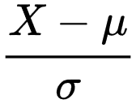
STANDARDIZATION – What is it?
Standardization (or Z-score normalization) means that a feature has a mean of 0 and standard deviation of 1.
The procedure involves subtracting each observation from the mean and then dividing by the standard deviation
The result of standardization is that the features will be rescaled so that they’ll have the properties of a standard normal distribution with
μ=0 and σ=1
μ (mu) → MEAN and σ (sigma) → STANDARD DEVIATION

Slide 9
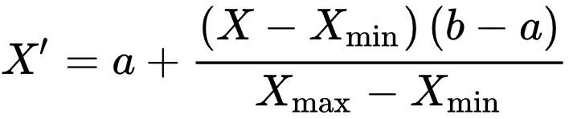
NORMALIZATION – What is it?
Normalization is the process of converting a numerical feature into a standard range of values.
a.k.a min-max normalization
The range of values might be either [-1, 1] or [0, 1].
In contrast to standardization, the cost of having this bounded range is that we will end up with smaller standard deviations, which can suppress the effect of outliers. Thus Min-Max normalization is sensitive to outliers.

Slide 10
STANDARDIZATION EXAMPLE
Feature 1 | Feature 2
6 | …
2 | …
3 | …
1 | …

Slide 11
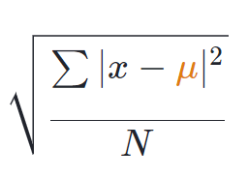
STANDARDIZATION EXAMPLE
Feature 1 | Feature 2
6 | …
2 | …
3 | …
1 | …
MEAN (FEATURE 1)= (6+2+3+1)/4=3 →μ
STD. DEV (FEATURE 1)=

Slide 12
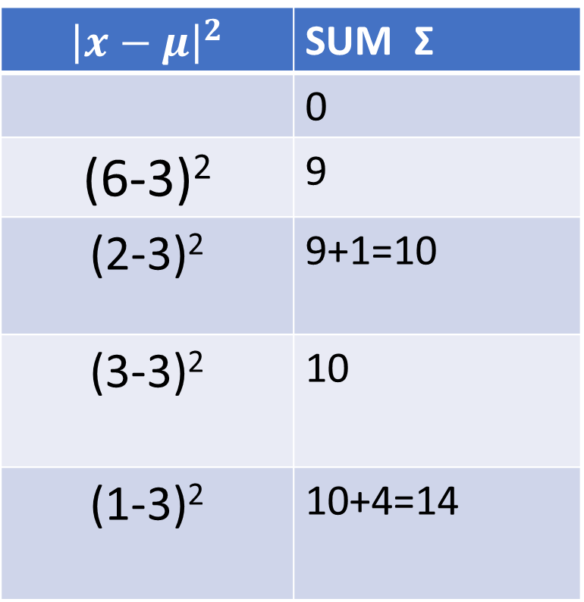
STANDARDIZATION EXAMPLE
Feature 1 | Feature 2
6 | …
2 | …
3 | …
1 | …
$${\left|x−μ\right|}^{2}$$ | SUM Σ
 | 0
(6-3)² | 9
(2-3)² | 9+1=10
(3-3)² | 10
(1-3)² | 10+4=14

Slide 13
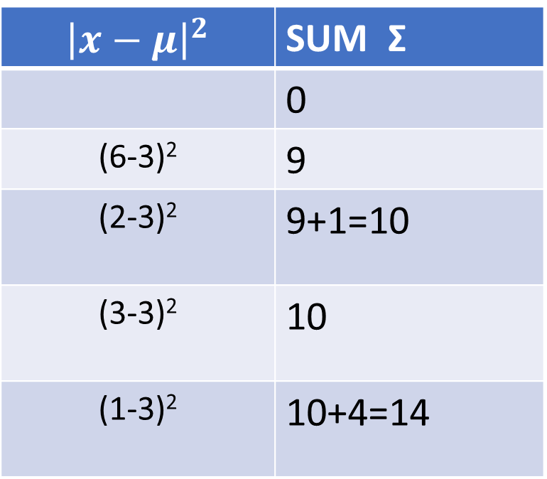
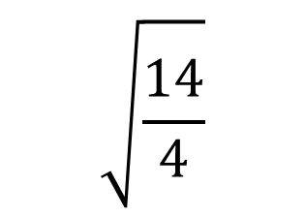
STANDARDIZATION EXAMPLE
Feature 1 | Feature 2
6 | …
2 | …
3 | …
1 | …
$${\left|x−μ\right|}^{2}$$ | SUM Σ
 | 0
(6-3)² | 9
(2-3)² | 9+1=10
(3-3)² | 10
(1-3)² | 10+4=14
$$\sqrt{\frac{14}{4}}$$
1.87

Slide 14
STANDARDIZATION EXAMPLE
Feature 1
6
2
3
1
Feature 1 z-score NORMALIZED
(6-3)/1.87=1.604
(2-3)/1.87= -0.535
(3-3)/1.87=0
(1-3)/1.87=-1.069
IF YOU CALCULATE THE MEAN AND STD.DEV., YOU WILL SEE THAT THE MEAN IS EQUAL TO 0 AND STANDARD DEVIATION IS EQUAL TO 1 FOR THE NORMALIZED FEATURE

Slide 15
MIN-MAX NORMALIZATION EXAMPLE
Feature 1
6
2
3
1
Feature 1 min-max NORMALIZED
?
?
?
?

Slide 16

MIN-MAX NORMALIZATION EXAMPLE [a=0,b=1]
Feature 1
6 → MAX
2
3
1 → MIN
Feature 1 min-max NORMALIZED
?
?
?
?
Feature 1 min-max NORMALIZED
=0 + (6-1)(1-0)/(6-1) =1
= 0 +(2-1)(1-0)/(6-1)=0.2
=0 + (3-1)(1-0)/(6-1)=0.4
=0 + (1-1)(1-0)/(6-1)=0

